Slide 1
The exact solutions in cosmological models based on the Teleparallel Gravity
Eugene Dentsel
Bauman Moscow State Technical University

Slide 2
Abstract
Introduction
Fundamental teleparallel gravity. Metric-affine gravity and tetrad formalism.
Modified Teleparallel gravity models. Generalised scalar-torsion gravity: сosmological background, ansatz method and its application to models of inflation.
Conclusion.

Slide 3
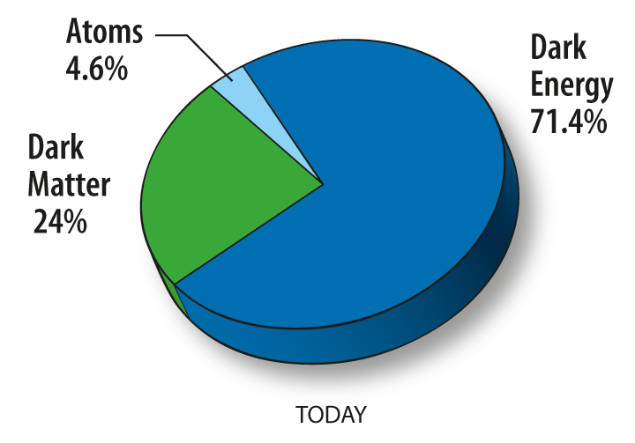
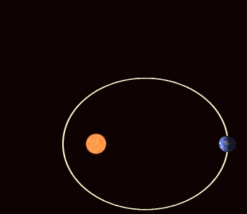
General Relativity Theory (GR)
GR precisely describes dynamics in context of solar system and predicts:
Gravitational lensing;
Perihelion precession of Mercury;
Gravitational waves;
Black holes.
Perihelion precession of Mercury
Content of the universe (WMAP)

Slide 4
Construction principles of GR modifications
Modification approaches:
The “Relativity Principle”
The “Equivalence Principle”
The “Causality Principle”
The “Lorentz Covariance”
Adding «dark sector» to right-hand side of Einstein equations
Modifications of gravitational sector, i.e. left-hand side
Metric-affine Gravity
Fundamental variables
metric $g_{μν}$
coefficien𝑡𝑠 𝑜𝑓 𝑎𝑛 𝑎𝑓𝑓𝑖𝑛𝑒 𝑐𝑜𝑛𝑛𝑒𝑐𝑡𝑖𝑜𝑛 ${\hat{Г}}_{μν}^{ρ}$

Slide 5
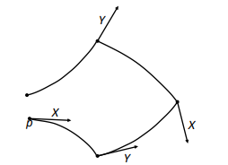
Characteristic tensors
A pictorial view of the breaking of parallelograms induced by torsion
Schematic geometrical representation of the curvature, torsion and non-metricity tensors
by their effect on the parallel transport of vectors

Slide 6
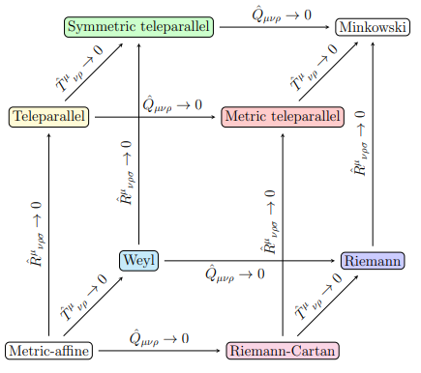
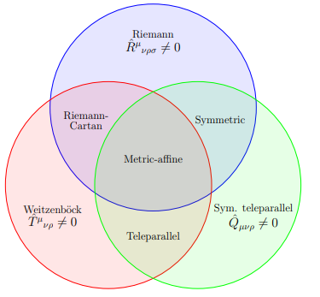
Relation between different metric-affine geometries
Classification of metric-affine geometries

Slide 7
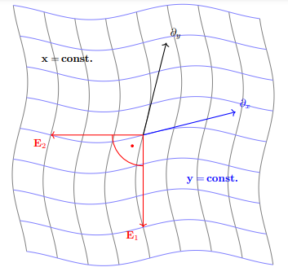
Tetrad formalism
Relation between affine and spin connections
The tetrad postulate
$ω_{bμ}^{a}≡0$ – Weitzenböck gauge
Graphical representation of the tetrad, reduced to a 2 dimensional model manifold
$$\left(E_{1}, E_{2}\right)=\left(E_{1}^{μ}∂_{μ},E_{2}^{μ}∂_{μ}\right)$$
Weitzenböck connection and the relation between the Levi Civitta connection

Slide 8
Teleparallel Gravity (TEGR)
An action, considered by Einstein in absolute parallelism theory $c_{1}, c_{2}, c_{3} = const, L_{1}, L_{2}, L_{3}$ - invariants of the torsion tensor. For $c_{1}=\frac{1}{2}, c_{2}=\frac{1}{4} и c_{3}=−1$ equations of motion are the same as in GR
The Einstein-Hilbert action
The Teleparallel action

Slide 9
Modified Teleparallel Gravity Theories
Changing geometry (Non-Riemannian geometry)
Adding invariants (Higher-order theories)
Quantization (Quantum gravity theories)
Adding new fields (Tensor-vector-scalar theories)
Changing dimension (D-dimensional theories)

Slide 10
$f(T)$ cosmology
Methods of adding the dark matter sector.
extended -> $f\left(R\right)$ - gravitation with Lagrangian as the non-linear function of scalar curvature
modified -> Lagrangian as the non-linear function of torsion
$p_{m}$ и $ρ_{m}$, $u_{μ}$ - pressure, energy density
and four velocity of the matter fluid
$S_{ρ}^{ μν}$- superpotential
FRW metric

Slide 11
Generalized scalar-torsion gravity
$$S=\int{d^{4}x e\left[f\left(T, φ\right)+P\left(φ\right)X\right]}$$
$$X=\frac{1}{2}∂_{μ}φ∂^{μ}φ$$
$$f\left(T,φ\right)=−\frac{M_{pl}^{2}}{2}T−G\left(T\right)F\left(φ\right)−V\left(φ\right)$$
The general action
In standard formulation of teleparallel gravity there is no Lorentz covariance
$e_{ μ}^{A} = diag(1,a,a,a)$ corresponds to FRW metric:
$$ds^{2}=−dt^{2}+a^{2}δ_{ij}dx^{i}dx^{j}$$
For TG, $f ∼ T→$ local invariance is restored.
For MTG the variation of the action $δS=\int{d^{4}xe∂_{ρ}f_{,T}S_{μν}^{ ρ}ξ^{μν}}$ leads to$∂_{ρ}f_{,T}≠0→$ a set of six equations for six additional degrees of freedom, due to violation of local Lorentz symmetry

Slide 12
Cosmological background
Background equations
$$\left\{\begin{aligned}f\left(T,φ\right)−P\left(φ\right)X −2 T f_{,T}=0 \\ f\left(T,φ\right)+P\left(φ\right)X −2 T f_{,T}−4\dot{H}f_{,T}−4H\dot{f_{,T}}=0 \\ −P_{,φ}X−3P\left(φ\right)H\dot{φ}−P\left(φ\right)\ddot{φ}+f_{,φ}=0 \end{aligned}\right.$$
$H=\frac{\dot{a}}{a}$ - Hubble rate $T=6H^{2}$ , $X=\frac{1}{2}{\dot{φ}}^{2}$ , $a=a\left(t\right) −a scale factor$
$v_{k}^{′′}+\left[k^{2}−\frac{1}{τ^{2}}\left({\tilde{v}}^{2}\right)−\frac{1}{4}\right]v_{k}=0$ - the Mukhanov- Sasaki equation $v=z R$ - the canonically-normalized Mukhanov variable
For $τ=\left(−\frac{1}{aH}\right)\left(1+ε\right)$ at first order and $R_{k}=z^{−1}v_{k}=\left(\frac{H}{k}\right)\left(\frac{k}{aH}\right){\left(2Q_{s} \right)}^{−\frac{1}{2}}v_{k}$ $\left|R_{k}\right|≈\frac{H}{2\sqrt{k^{3}Q_{s}}}{\left(\frac{k}{aH}\right)}^{\frac{3}{2}−\tilde{v}}$
$$P_{s}=\frac{k^{3}}{2π^{2}}\left|R_{k}\left(τ\right)\right|$$
The scalar power spectrum of curvature perturbation

Slide 13
Slow-roll parameters
$ε=−\frac{\dot{H}}{H^{2}}$, $δ_{PX} = −\frac{P\left(φ\right)X}{2H^{2} f_{{,T}_{ } }}$ , $δ_{f_{,T}}=\frac{{\dot{f}}_{,T}}{Hf_{,T}}$ , $ε=δ_{PX}+δ_{f_{,T}}$
Perturbation parameters
$P_{s}≈\frac{H_{k}^{2}}{8π^{2} Q_{sk}}$ the scalar power spectrum of curvature perturbation at the time of crossing the Hubble radius $Q_{sk}=Q_{s}\left(k=aH\right), H_{k}=H\left(k=aH\right)$, $Q_{s}=\frac{PX}{H^{2}}=\frac{A\left(t\right)}{H^{2}}$
$η=δ_{P}+2δ_{φ}+2ε$, $η_{R}=δ_{f_{,T}}\left[\left(1+\frac{δ_{fX}}{δ_{PX}}\right)\frac{δ_{f_{,T}}}{δ_{f_{\dot{H}}}}\right]$, $δ_{P}=\frac{\dot{P}}{HP}, δ_{φ}=\frac{\ddot{φ}}{H\dot{φ}}$
$n_{s}−1={\left.\frac{dln P_{s}\left(k\right)}{d\ln{k}}\right|}_{k=aH}=−2ε−η+2η_{R} , k=aH$ a scale-dependence of the scalar power spectrum
$r=8\left(ε−δ_{f_{,T}}\right)$ the tensor-to-scalar ratio for s=4

Slide 14
Exact solutions
equations of motion:
$$f\left(T,φ\right)−\frac{c}{2}−2Tf_{,T}=0 \\ −3\sqrt{\frac{T}{6}}\frac{c}{\dot{φ}}+f_{,φ}=0$$
$$P\left(φ\right){\dot{φ}}^{2}=A\left(t\right)$$
Physical constraints: $$r<0.065$$
$$n_{s}=0.9663±0.0041$$
$$P_{s}=A_{s}=2.1∙{10}^{−9}$$
$N=60$ – the number of e-folds
$$N=\int{H\left(t\right)dt}$$
$$t=t(N)$$
Numerical solutions for $r\left(n_{s}\right)$

Slide 15
$H\left(t\right)=a{\left[\frac{b+4}{6ab}t\right]}^{−\frac{b}{b+4}}$, $φ\left(t\right)={\left[\frac{b+4}{6ab}t\right]}^{\frac{2}{b+4}}$
equations of motion
$$f\left(T,φ\right)−\frac{c}{2}−2Tf_{,T}=0 \\ −3\sqrt{\frac{T}{6}}\frac{c}{\dot{φ}}+f_{,φ}=0$$

Slide 16
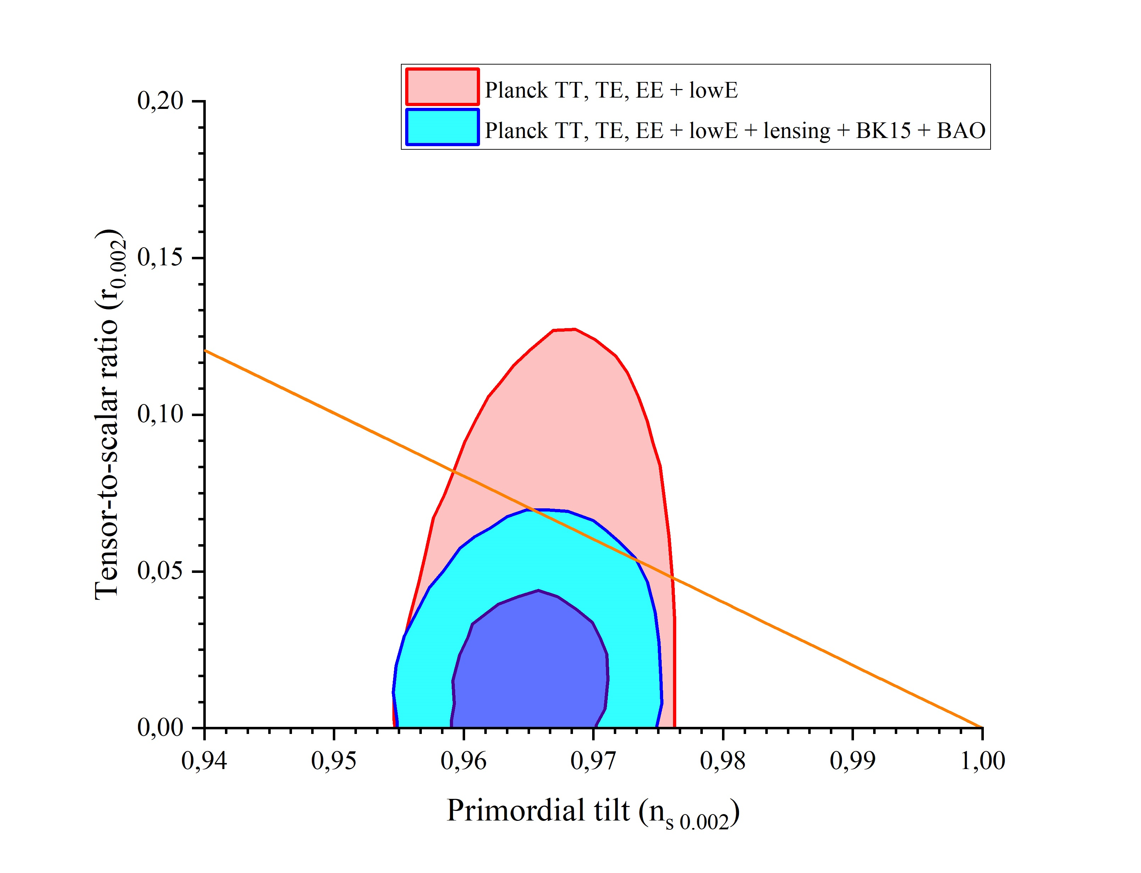
The dependence $r = r(n_{S})$ for parameters s =4, $c=1, c_{1}=100,c_{2}=−0.1$ and $b∈\left[0.036,0,17\right]$ with constraints on the tensor-to-scalar ratio $r_{0.002}$ due to the Planck observations.

Slide 17
Conclusion
Modified Teleparallel Gravity Theories are reviewed and the generation of primordial fluctuations in generalized teleparallel scalar-torsion gravity theories is studied.
Lagrangian density includes an arbitrary function $f\left(T,φ\right)$ of the torsion scalar and scalar field. Replacing the kinetic term as the function of time $P\left(φ\right)X=A(t)$ allows to contruct a consistent gravity theory with torsion. Numerical solutions shows, that for some models based on GR exact cosmological solutions corresponds to the observational constraints.

